Slide 1
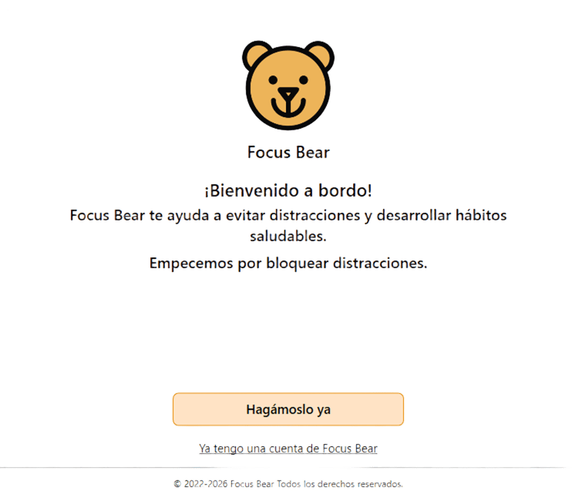
Focus Bear
Windows V. 200.0
Recommendations.
Nelly Molina
February 27, 2026.

Slide 2
Comments
&
Preference ideas.
Focus Bear

Slide 3
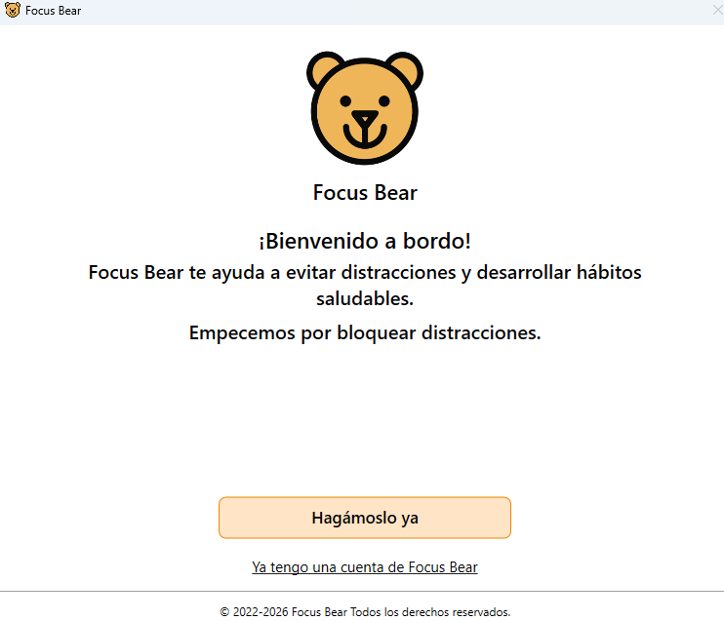


You can give a presentation such as:
Welcome aboard!
Focus Bear helps you stay focused and create healthy habits.
Let's start being productive!

Slide 4
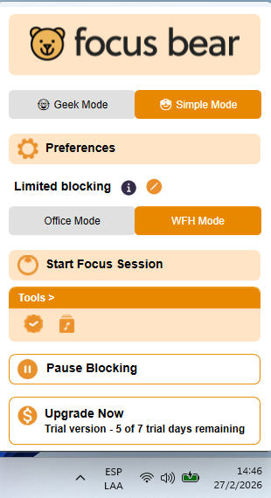

When you need help in the limited blocking mode section, don't select it.
It also does not translate functions.

Slide 5
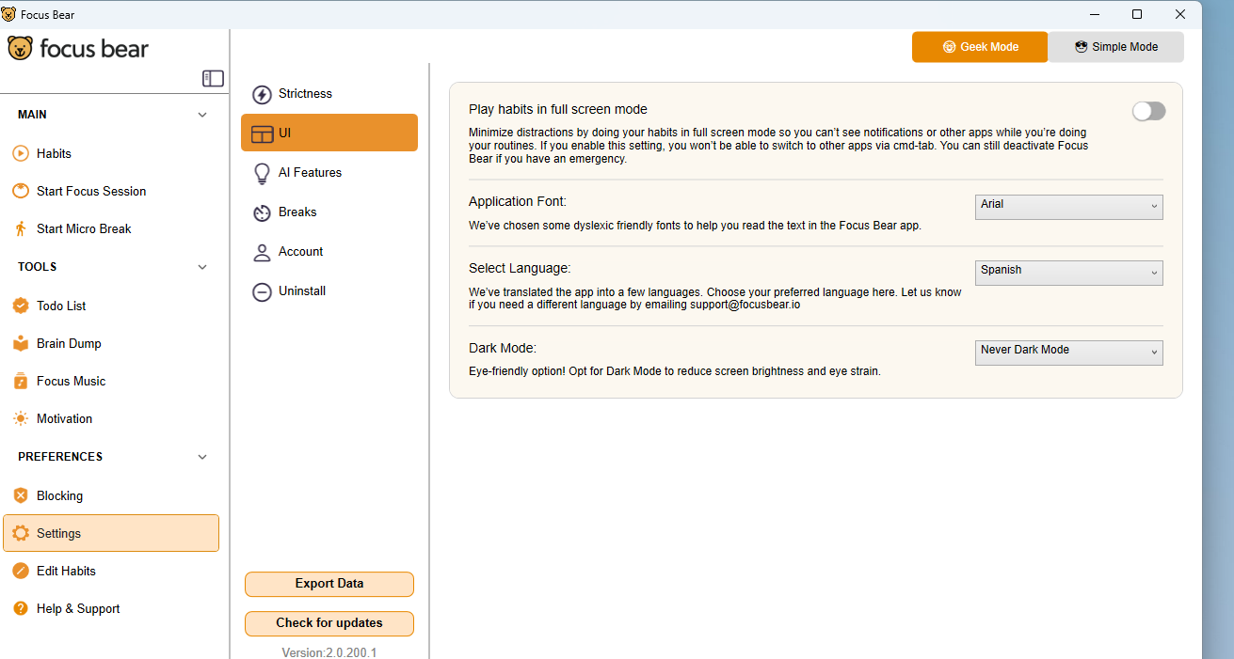

The language selection is unstable; it does not remain constant.

Slide 6
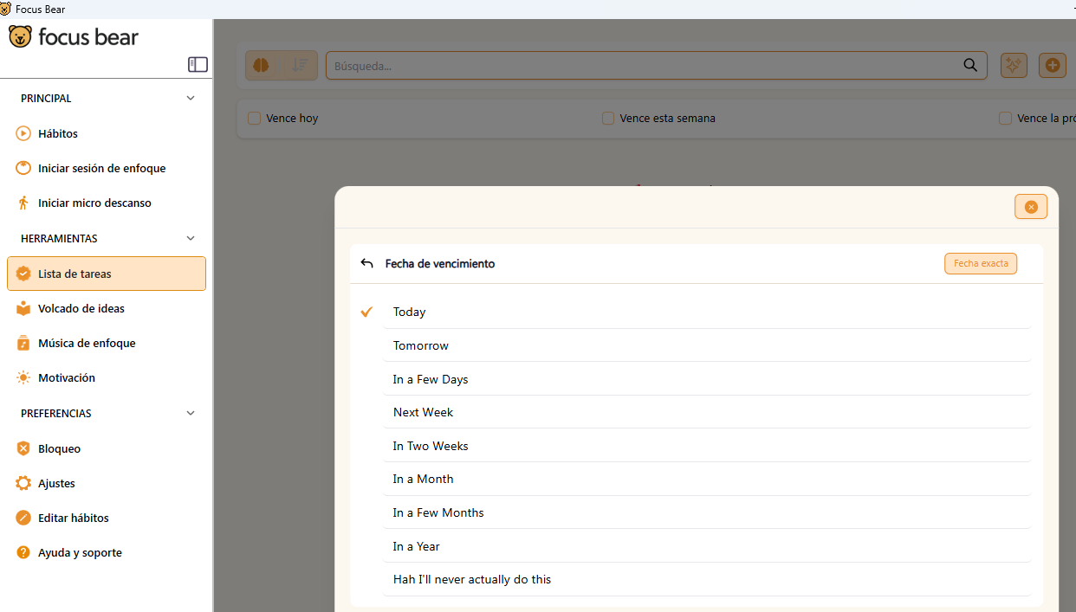
In the task list section, when a task is added, it should be possible to assign a due time, since only the date on which the task will be performed is assigned. By assigning a time, we can even set the app to send us a reminder in a push notification, which can also be programmed to remind us at a stipulated time to perform the task in advance.

Slide 7
Also in this section, you can see that the options have not been translated. In this case, they have not been translated into Spanish, which may be confusing for the user.

Slide 8
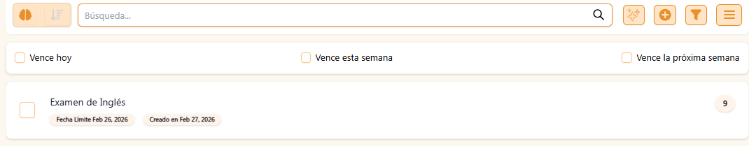
Also, when attempting to create a task that must be completed on the same day, it schedules it as if the deadline were the previous day when it should be the current date, in this case the same date of creation.

Slide 9
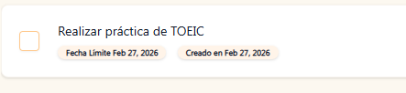
The same thing happens if I assign a task for the next day: it marks it with the same day's deadline, when it should indicate that it is for the next day until a certain time.

Slide 10
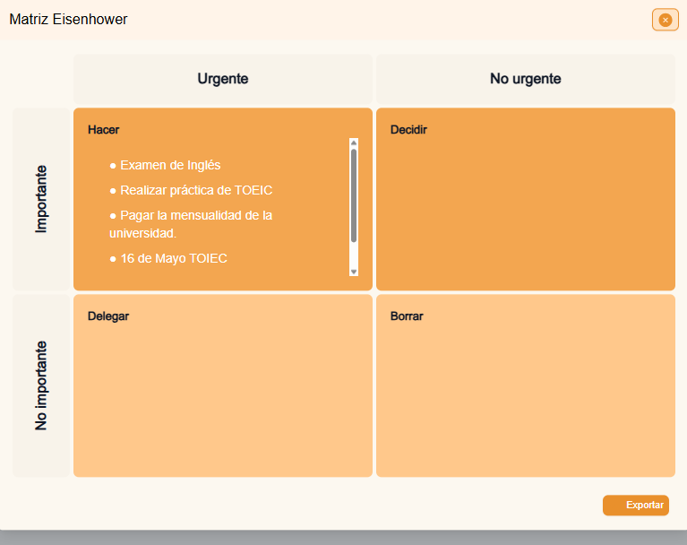
I schedule all activities as important even though they have different intervals.
Schedule all activities as important, even if they have different deadlines, and there is no help option on how to place them in the “do,” “decide,” “delegate,” and “delete” sections.

Slide 11
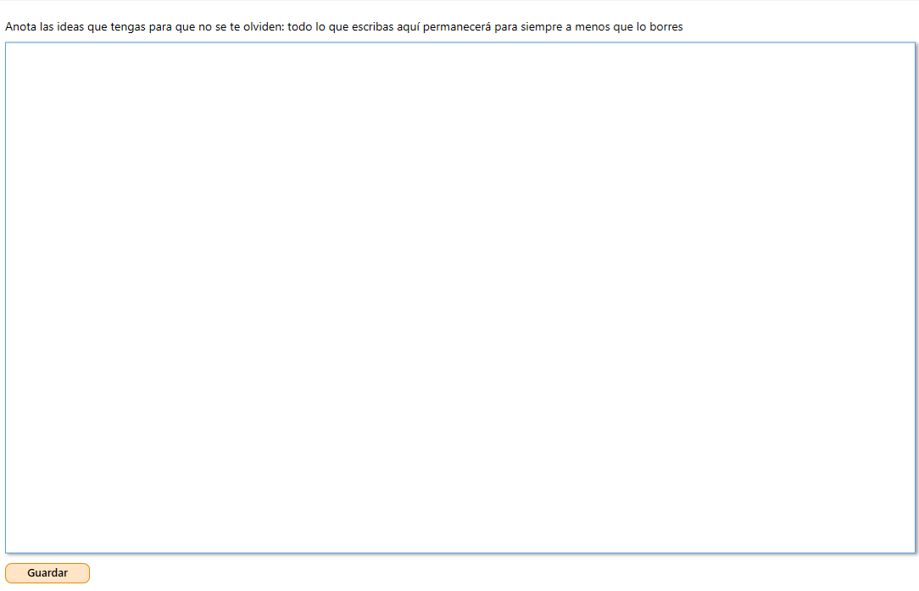
In the “Brainstorming” section, I think it should be more attractive, where you can create several sections to organize ideas, instead of a simple table. It should be possible to create different pages so that ideas are clear about how they will be used and in what way.

Slide 12
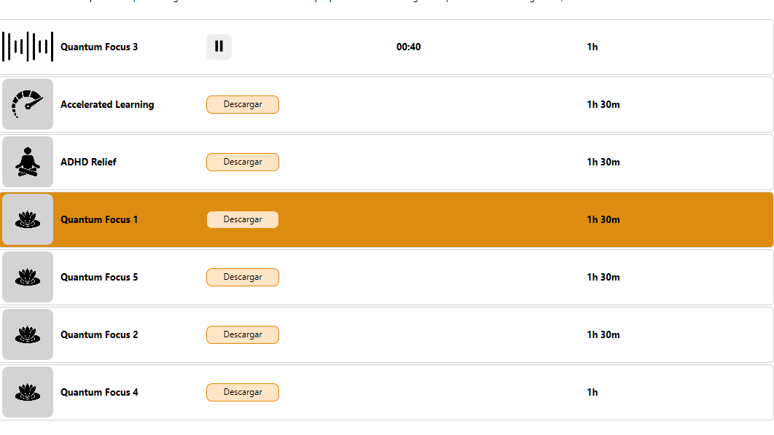
In the music section, it is necessary to download it, which could be simplified so that it is already included. Once the music audio is downloaded, it plays, but the music does not sound and ends without anything being heard.

Slide 13
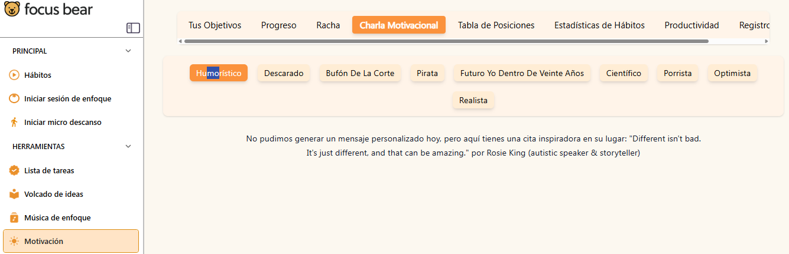
In the motivation section, under “motivational talk,” if you select the type of talk you want, it doesn't provide it, it just gives you an inspirational quote. This inspirational quote could also be added at the beginning and end of the day, or after each concentration session or at the end of a routine, to make users feel satisfied.

Slide 14
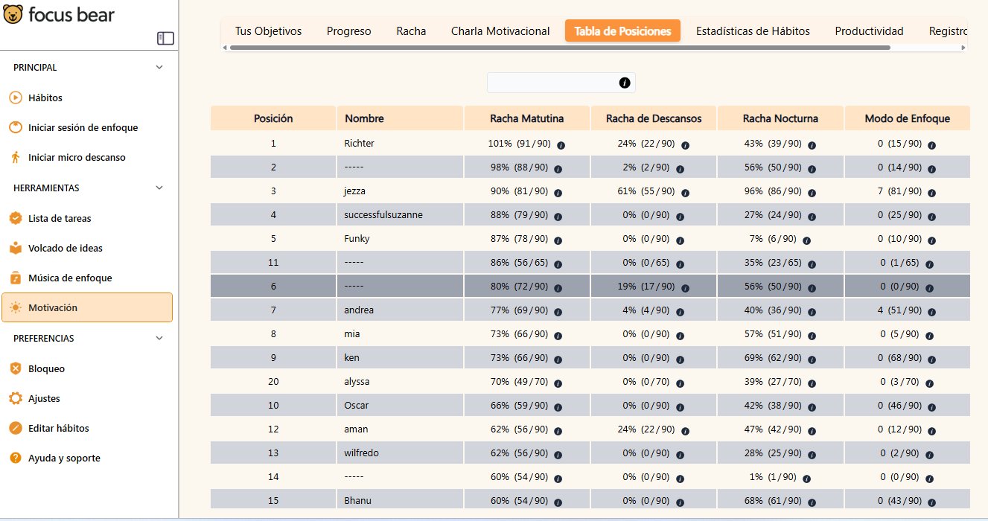
The leaderboard is a good idea for keeping users competitive, but it can cause stress for some, as many neurodivergent people become demotivated when they are not in the position they want to be in. Therefore, it should be optional to be part of this section or not.
Similarly, it should be made more attractive with real-time updates of the tasks completed by each user and some kind of badge or recognition for the level each person reaches.

Slide 15
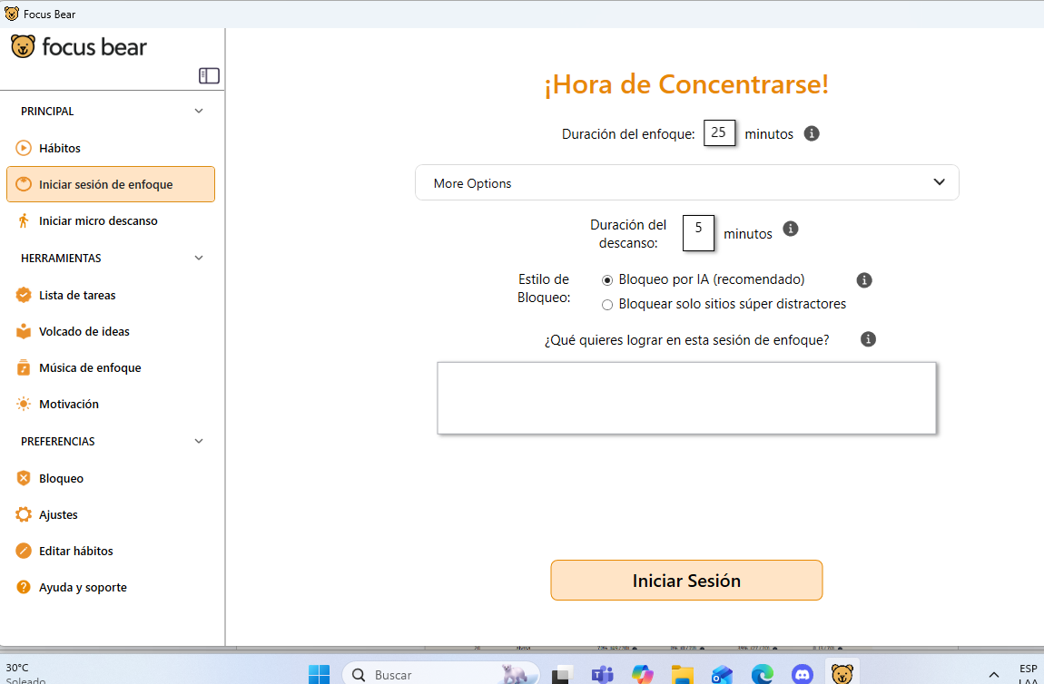
The help buttons are not responding.
In the concentration section, the timer programmer is very complex because it only allows you to set times in minutes. An improvement could be to set the hour and minutes and then have a section to program breaks, so that you can program the desired breaks, from 1 to 3, depending on what is most convenient according to the time interval of the concentration session.
Similarly, the programmer could have a more attractive appearance.

Slide 16
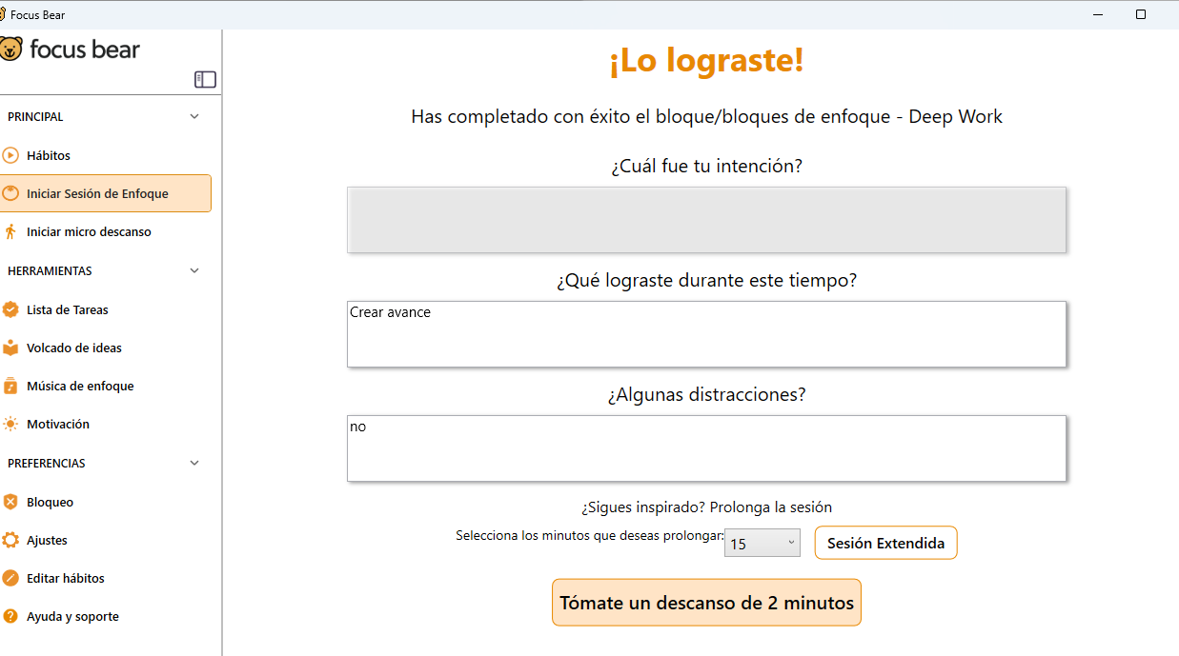
In the section on the purpose of the focus session, it is not possible to make selections or write anything.

Slide 17

It has bugs, as there are times when a block has not been set, and the app gives you the option to stop it even if you haven't programmed it.

Slide 18
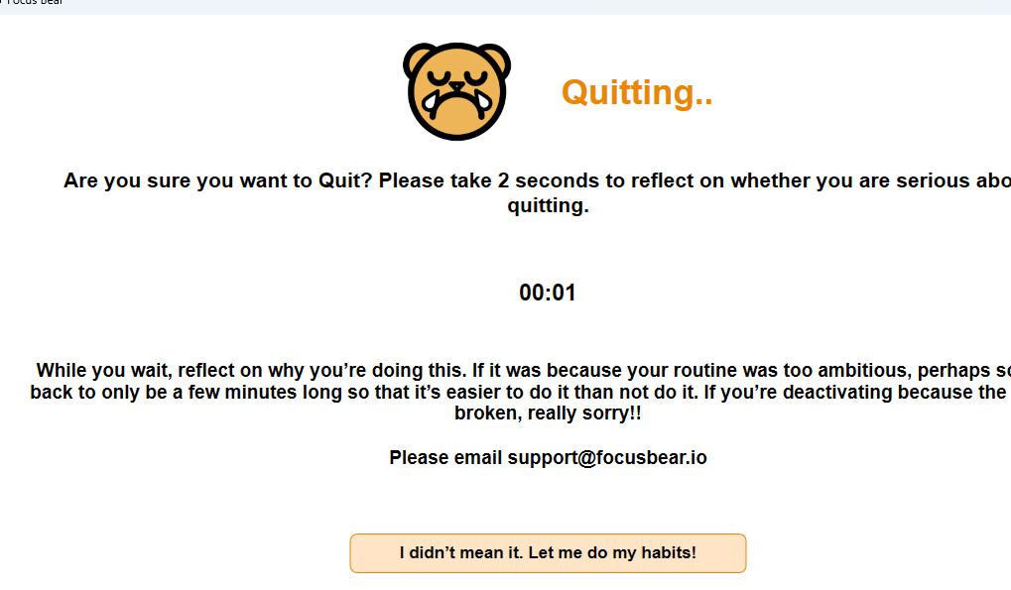
The reading time is too short; the user will probably not take the time to think about it but will act to close it.

Slide 19
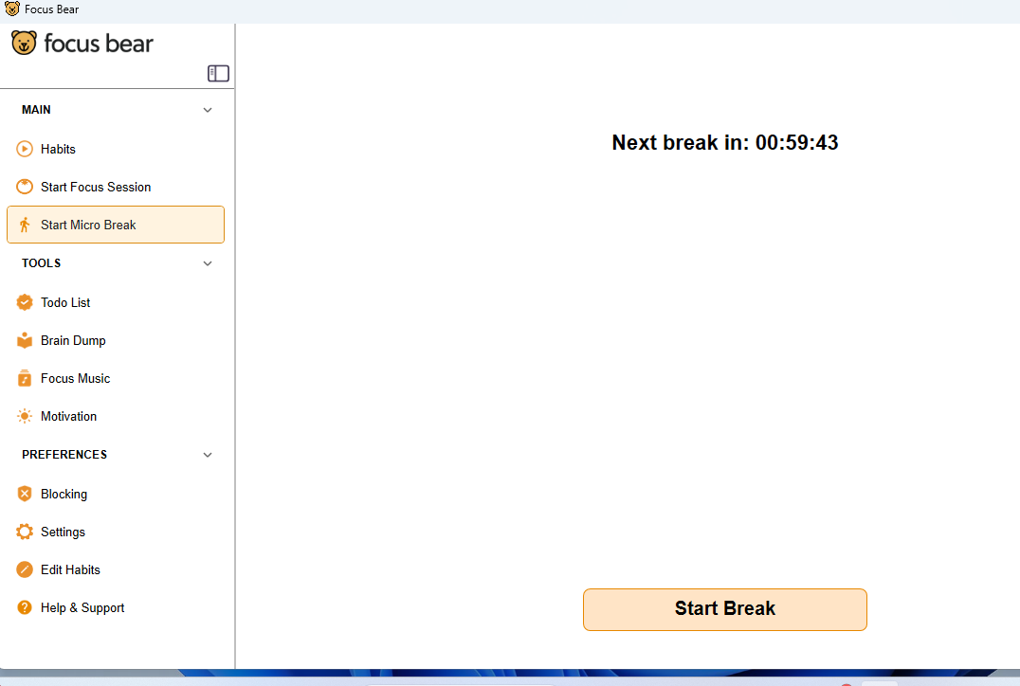
The app is very slow, the micro breaks section freezes time and does not change it as the seconds pass.

Slide 20
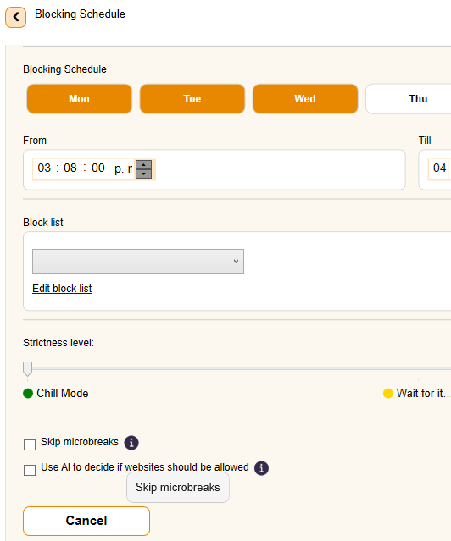
The help buttons in the blocking schedule section are not responding.

Slide 21
These were the observations for the desktop app. It contains several errors that can be corrected. One of the things that stands out most in my opinion is the presentation. As a suggestion, make it more attractive and perhaps dynamic. There are also problems with language selections, and it runs slowly. Otherwise, the other functions work well.

Slide 22
The mobile app test worked correctly, the servers are fast, although some AI generation features should include a help section, as the information needed to understand how to use them is not clearly indicated and some users find it confusing. On the other hand, I like the aesthetic presentation of the image, although they could make more attractive innovations in general. Otherwise, I don't see any other issues or recommendations at this time, although the leaderboard could be made optional for users if they wish.

